Slide 1
Java Programming
S Hima bindu sri
Assistant Professor
Dept. Of IT

Slide 2
Object-Oriented Thinking
A way of Viewing the World
Agents and Communities
Messages and Methods
Responsibilities
Classes and Instances

Slide 3
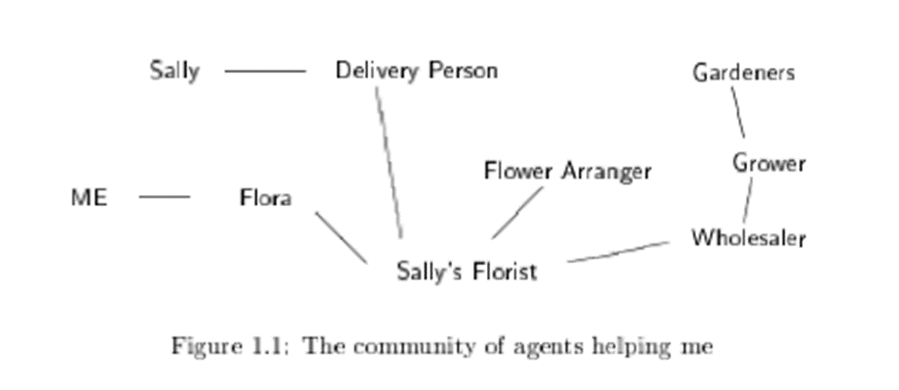
Agents and Communities

Slide 4
Agents and Communities
An object-oriented program is structured as a community of interacting agents, called objects

Slide 5
Agents and Communities
Each object has a role to play

Slide 6
Agents and Communities
Each object provides a service, or performs an action, that is used by other members of the community

Slide 7
Messages & Methods
Actions are initiated in object-oriented programming by the transmission of a message to an agent (an object) responsible for the action

Slide 8
Messages & Methods
The message encodes the request for an action and is accompanied by any additional information (arguments) needed to carry out the request

Slide 9
Messages & Methods
The receiver is the object to whom the message is sent

Slide 10
Messages & Methods
In response to a message, the receiver will perform some method to satisfy the request

Slide 11
Responsibilities
A fundamental concept in object-oriented programming is to describe the behavior in terms of responsibilities

Slide 12
Object
It is the basic unit of Object Oriented Programming and it represents the real life entities.
Examples: student, teacher, fan, dog, pen,….etc.
Real-life entities share two characteristics : they all have state and behavior.

Slide 13
An Object Consists of
State: It is represented by attributes of an object.
Behavior: It is represented by methods of an object.
Identity: It gives a unique name to an object.

Slide 14
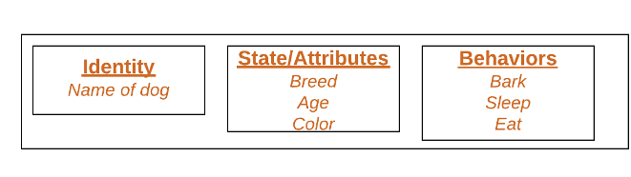
Example-Dog object

Slide 15
Class
A class is a user defined blueprint or prototype (template) from which objects are created.
It represents the set of properties or methods that are common to all objects of one type.
It has definitions of methods and data.

Slide 16
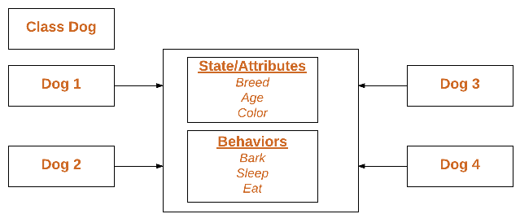
Class Example - Dog

Slide 17
Class Hierarchies-Inheritance
Classes are organized into a hierarchical inheritance structure.
A child class (or subclass) will inherit attributes from a parent class higher in the tree
An abstract parent class for which there are no direct instances, it is used only to create subclasses.

Slide 18
Method Binding, Overriding, and Exceptions
Determining which method will be invoked at run-time
In response to a message, the search for a method begins with the class of the receiver
If no method is found, the search is conducted in the parent class
The search continues up the parent class chain until either a method is found or the chain is exhausted
If the method is found, it will be executed
If not, an error message is issued.
Methods of the same name in the class hierarchy is overriding

Slide 19
Summary of Object-Oriented Concepts
Everything is an object.
Computation is performed by objects communicating with each other by sending and receiving messages.
Each object has its own memory.
Every object is an instance of a class.
The class is the repository for behaviour associated with an object.
Classes are organized into a singly rooted tree structure, called the inheritance hierarchy .

Slide 20
An overview of Java
Java was originally developed by James Gosling at Sun Microsystems (which has since been acquired by Oracle Corporation)
1991, first version called “OAK” was released and in 1995 the name “Java” came into existence.
Oracle Corporation is the current owner of the official implementation of the Java SE platform.
The Oracle implementation is available for Microsoft Windows, Mac OS X, Linux and Solaris.
Java is reliable, portable and easy to use.

Slide 21
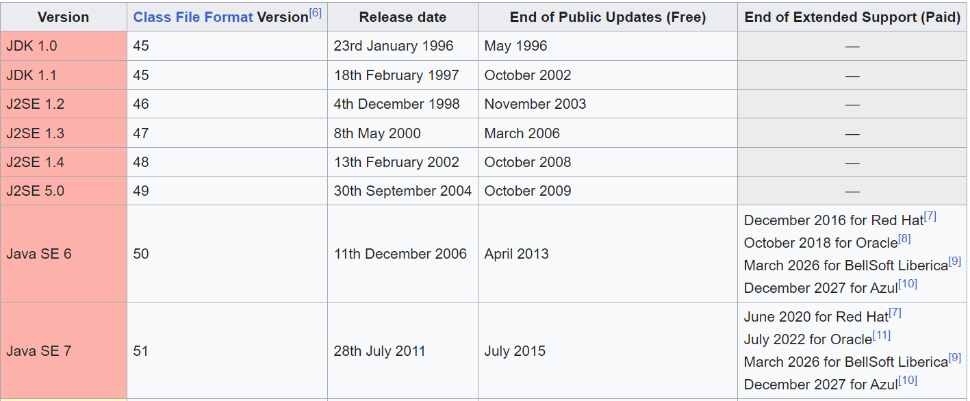
Java releases
.

Slide 22
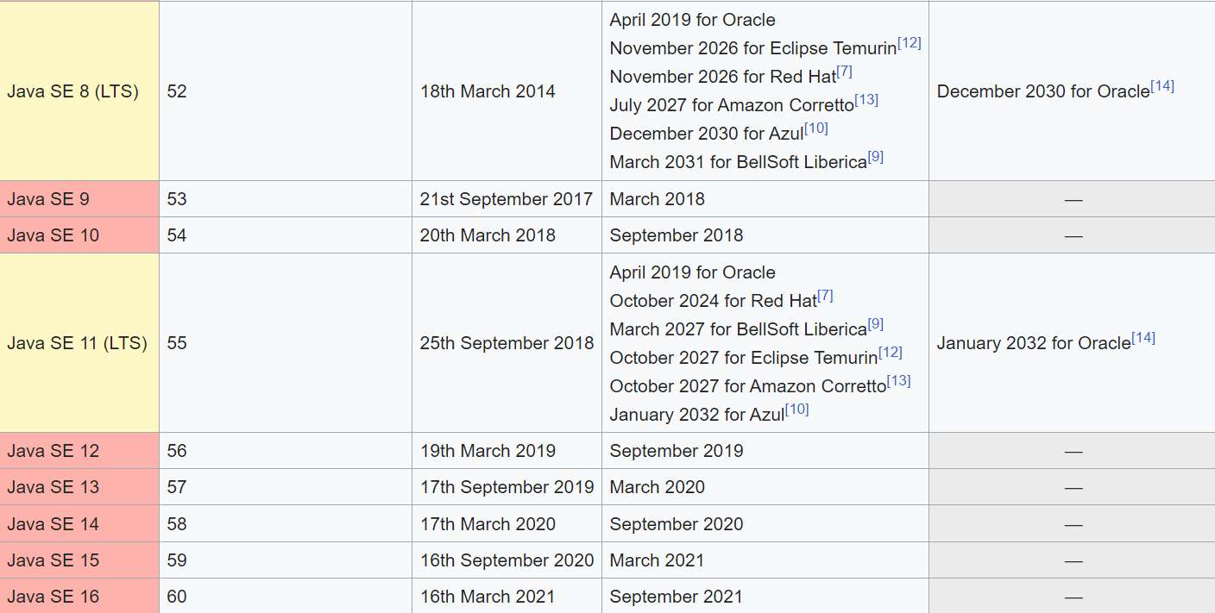

Slide 23
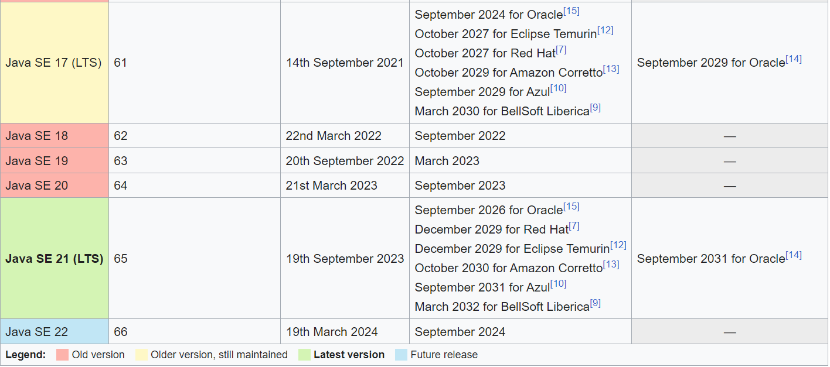

Slide 24
Java releases
Java 1.02
200 classes
Java 1.1
500 classes
Java 2 (versions 1.2 to 1.4)
2300 classes
Comes in 3 editions: Micro Edition (J2ME), Standard Edition (J2SE) and Enterprise Edition (J2EE)
Widely used for web-based and mobile applications
Java 5.0 (versions 1.5 and up)
3500 classes

Slide 25
What is Java Programming language
Java is a general-purpose computer programming language .
It is intended to let application developers “write once, run anywhere” (WORA).
WORA is achieved by compiling a Java program into an intermediate language called bytecode.
The format of bytecode is platform-independent.
A virtual machine, called the Java Virtual Machine (JVM), is used to run the bytecode on each platform.
Different JVMs are written specifically for different host hardware and OS.

Slide 26
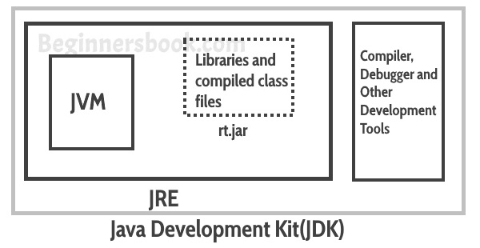

What is Java JDK, JRE and JVM?

Slide 27
What is Java JDK, JRE and JVM?
Java Virtual machine (JVM) is the virtual machine that runs the Java bytecodes.
JVM uses two inbuilt interpreter and JIT compiler to convert the bytecode to machine code and execute it.
The Java Runtime Environment (JRE) is a software package which bundles the libraries (jars) and the Java Virtual Machine to run applications written in the Java.
JDK is a superset of JRE. JDK contains everything that JRE has along with development tools for developing, debugging, and monitoring Java applications.

Slide 28
O0PS Concepts
Encapsulation
Abstraction
Inheritance
Polymorphism

Slide 29
Data Hiding & Encapsulation
Using private access modifier(specifier), we can hide data from other classes.
Binding data and its operations together into a single unit is known as encapsulation.
A java class is the example of encapsulation.

Slide 30
Abstraction
Hiding internal details (implementation details) and showing functionality is known as abstraction.
For example phone call, we don't know the internal processing.
In Java, we use abstract class and interface to achieve abstraction.

Slide 31
Inheritance
Inheritance in Java is a mechanism in which one object acquires all the properties and behaviors of a parent object.
Existing class: Super Class / Base Class / Parent Class
New class: Sub Class / Derived Class / Child Class

Slide 32
Inheritance(contd..)
The idea behind inheritance in Java is that you can create new classes that are built upon existing classes.
When you inherit from an existing class, you can reuse methods and fields of the parent class.
Moreover, you can add new methods and fields in your current class also.

Slide 33
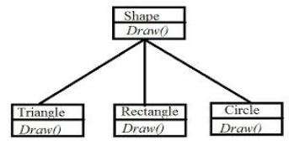
Inheritance(contd..)
Inheritance represents the IS-A relationship which is also known as a parent-child relationship.
We can say Triangle IS-A Shape, Rectangle IS-A Shape..etc.

Slide 34
Inheritance(contd..)
Why use inheritance in java
For Method Overriding (so runtime polymorphism can be achieved).
For Code Reusability.

Slide 35
Polymorphism
Polymorphism is the ability of an object (methods) to take on many forms.
Generally it occurs when we have many classes that are related to each other by inheritance.
In Java, we use method overloading and method overriding to achieve polymorphism.

Slide 36
Java Installation & path setting
Java oracle: https://www.oracle.com/in/java/technologies/javase/javase-jdk8-downloads.html
YouTube link: https://www.youtube.com/watch?v=f7rT0h1Q5Wo

Slide 37
Hello world program
class Test
{
public static void main(String args[])
{
System.out.println("Hello World");
}
}

Slide 38
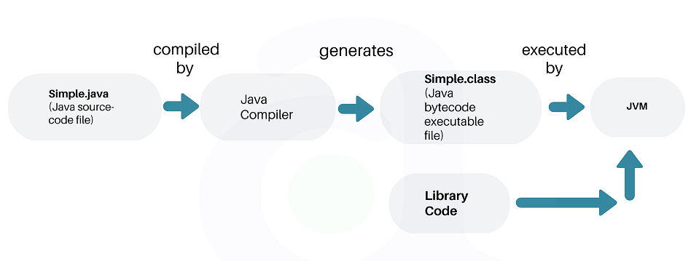
Execution of a Java Program

Slide 39
The Java Buzzwords/Features
Simple
Object Oriented
Portable
Platform Independent
High Performance
Architecture-neutral
Robust
Multithreaded
Distributed
Secure
Dynamic

Slide 40
Simple
Java is easy to learn and its syntax is quite simple, clean and easy to understand.
Java inherits the C/C++ syntax and many of the object-oriented features of C++.
Java has removed many complicated and rarely-used features, for example, explicit pointers, operator overloading, etc.

Slide 41
Object Oriented
In java everything is an Object which has some data and behavior.
unlike C++, in java even the function main() has to be part of some class only.
We can’t have any method outside of the class.
Java can be easily extended as it is based on Object Model.

Slide 42
Portability
Any Application which can be transferred and run on any OS
For Ex:- Windows, Linux, Ubuntu
It is also called as Platform Independent language.
Test.cpp
Test.java
CPP Compiler
JAVA Compiler
Test.exe
Test.class
OS
JVM

Slide 43
High performance
Java is Compiled & Interpreted but High performance
Test.java
JAVA Compiler
Test.class
JVM (JAVA Interpreter)
Test.exe

Slide 44
Java enables the creation of cross-platform programs by compiling into an intermediate representation called Java byte code.
This code can be executed on any system that implements the Java Virtual Machine.
Java byte code was carefully designed so that it would be easy to translate directly into native machine code for very high performance by using a just-in-time (JIT)compiler.

Slide 45
Secure
Secure for Internet applications
Java raises out of boundary exception in arrays
Java is String typed language
No explicit pointer
Java Programs run inside a virtual machine sandbox.
Java Security Manager determines what resources a java class can access such as reading and writing to the local disk.

Slide 46
Robust
Java uses strong memory management.
There is no pointers, avoids security problems.
Manages memory allocation and de allocation (In fact, de allocation is completely automatic, because Java provides garbage collection for unused objects.)
Java makes an effort to eliminate error-prone situations by emphasizing mainly on compile time error checking and runtime checking(exception handling & type checking).

Slide 47
Multithreaded
Multithreading is a special type of Multitasking.
Thread:
Part of a program.
Sequence of instructions, which has independent path of execution.
Multithreading:
Concurrent execution of several parts(threads) of the same program at a time is multithreading.
Running multiple threads of a program simultaneously.
This improves CPU utilization (throughput)

Slide 48
Distributed
Java is distributed because it facilitates users to create distributed applications in Java.
Distributed application is a software that involves several computers working together on a network.
RMI (Remote Method Invocation) and EJB (Enterprise Java Bean) are used for creating distributed applications.
This feature of Java makes us able to access resources(objects/files) by calling the methods from any machine on the internet.

Slide 49
Architecture-neutral
Irrespective of architecture the memory allocated to the variables will not vary.
Even if Operating system upgrades, processor upgrades, and changes in any core system resources does not make a program to malfunction.
Java is “write once run anywhere anytime” language.

Slide 50
Dynamic
Java is a dynamic language.
Java programs carry with them substantial amounts of run-time type information that is used to verify and resolve accesses to objects at run time.
This makes it possible to dynamically link code in a safe and appropriate manner.
Java supports dynamic loading of classes. It means classes are loaded on demand.
Java supports dynamic compilation and automatic memory management (garbage collection).

Slide 51
Java 1.5 (5.0)’s Scanner class
Prior to Java 1.5 getting input from the console involved multiple steps.
Java 1.5 introduced the Scanner class which simplifies console input. It can also be used to read from files and Strings (among other sources).
Scanner is in the java.util package. So you must: import java.util.Scanner;
Scanner class is used for obtaining the input of the primitive types like int, double, strings, etc.

Slide 52
Scanner class
To create an object of Scanner class, we usually pass the predefined object System.in, which represents the Standard input stream.
We may pass an object of class File if we want to read input from a file
To read numerical values of a certain datatype XYZ, the function to use is nextXYZ().
For example, to read a value of interger, we use nextInt()
To read strings we use nextLine()
To read single character, we use next().charAt(0)
**next() is a function which returns the next token/word in the input as a string and charAt(0) function returns the first character in the string

Slide 53
Scanner class methods
Method | Description
nextBoolean() | Reads a boolean value from the user
nextByte() | Reads a byte value from the user
nextDouble() | Reads a double value from the user
nextFloat() | Reads a float value from the user
nextInt() | Reads a int value from the user
nextLine() | Reads a String value from the user
nextLong() | Reads a long value from the user
nextShort() | Reads a short value from the user

Slide 54
Creating Scanner objects
Constructing a Scanner object to read console input:
Scanner name = new Scanner(System.in);
Example:
Scanner s = new Scanner(System.in);
**You make a new object of Scanner class and you store it in variable s.
**At the same time you are calling the constructor of the class, with the parameter System.in

Slide 55
Creating Scanner objects
Now when you call
s.nextInt();
**You execute the method from the object you just created which returns integer
**Assign this value to an integer variable as
int i = s.nextInt();

Slide 56
Example
import java.util.Scanner;
class Example
{
public static void main(String args[])
{
Scanner s = new Scanner(System.in);
System.out.println(“Enter your name:”);
String name = s.nextLine();
System.out.println(“Name = “+name);
}
}

